Slide 1
Impetus Technologies Inc.
User Story Specific
Code Coverage Tool
(USSCC Tool)

Slide 2
Agenda
Problem Statement
Solution & Benefits
How it works
Tools Capability
Pre Requisites
Screenshots
How to Configure

Slide 3
Problem Statement
Legacy products in most of the cases have quite less code coverage.
We deliver new code in Sprints as User stories, on top of legacy code, but..
There are no tools available that give code coverage specific to User stories.

Slide 4
Solution & Benefits
USSCC Tool calculates code coverage specific to the user stories we deliver.
This gives clear picture in terms of percentage of code coverage for each user story.
And hence coverage result does not get diluted with usually low legacy code coverage or other user stories coverage.

Slide 5
How it works
Tool is available as a Plugin to SonarQube.
Add it as widget to Dashboard.
At start of sprint, configure plugin with list of user stories in sprint scope.
Generate sonar report for your project.
See Coverage Result on SonarQube Dashboard.

Slide 6
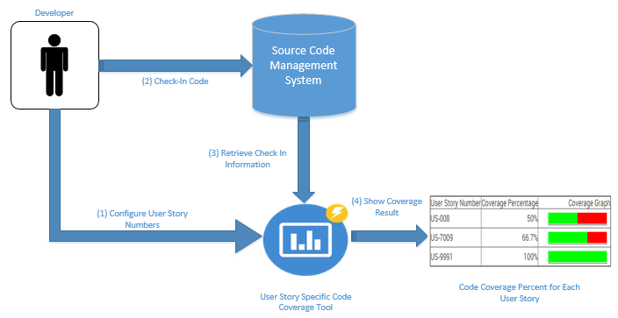
How it works

Slide 7
Tools Capability
Tool is currently supporting “SVN”,“Git” & IBM Clearcase code repositories.
It is interface driven, can be further extended to support any SCM repository.
Available as Sonar Plugin & Standalone Program.

Slide 8
Tools Capabilities
Support For Multi Module Projects
Downloadable not covered lines of code for userstories.
Support for latest SonarQube Version

Slide 9
Pre Requisites
Maven Project
Git, SVN or Clearcase as Repository
Developer need to check-in into repository with message containing user story number.
Project should create one of the below file with build
Jacoco.xml (for Jacoco)
Or coverage.xml (for Cobertura)
-> This can be done by minor pom modification.
Sonar Setup (For Sonar Plugin Only)
Local git setup or collabnet subversion software for svn

Slide 10
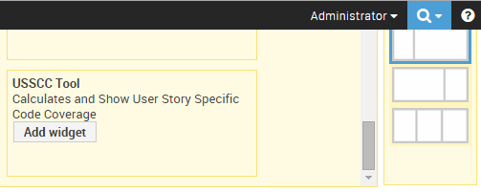
USSCC Plugin – Add to SonarQube Dashboard

Slide 11
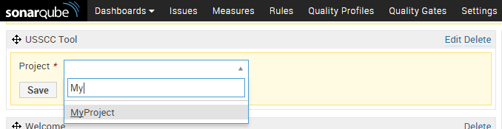
USSCC Plugin – Add to SonarQube Dashboard

Slide 12
How to configure
Provide a JIRA Login Id, Password and URL
Or Rally Key, Refer to below link on how to generate one
https://help.rallydev.com/rally-application-manager
OR, Configure list of user story as comma separated list.
Tool will take information from JIRA if details are provided or Rally if a key is provide and active sprint have user stories are present in JIRA or rally.
If no JIRA or rally information is provided or there a no active sprints or user stories in both, then it will accept user story as comma separated list as input.
Next slide show configuration screen.

Slide 13
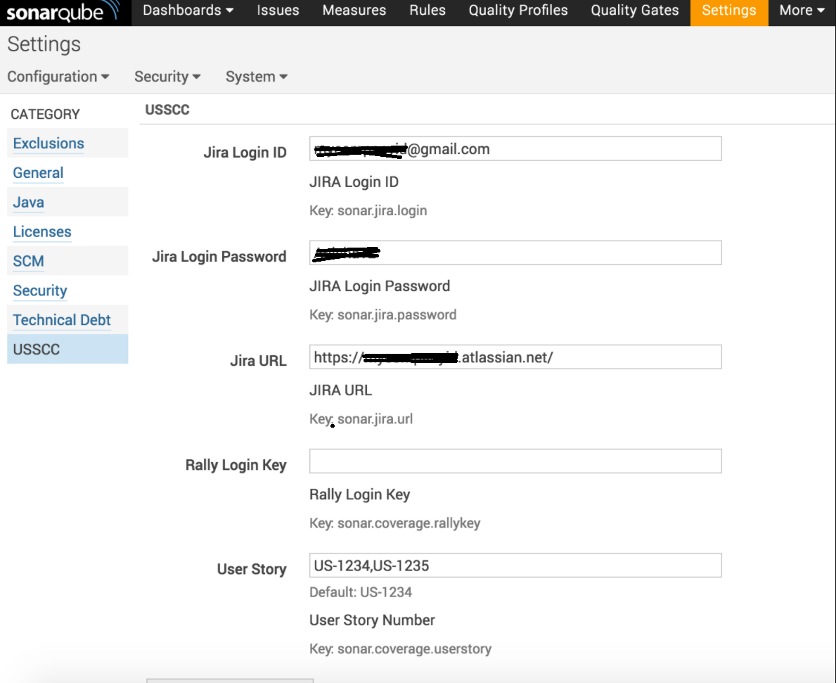
USSCC Plugin – Configure Plugin

Slide 14
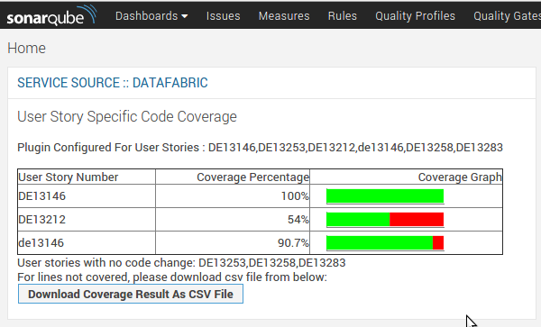
USSCC Plugin – Dashboard Widget

Slide 15
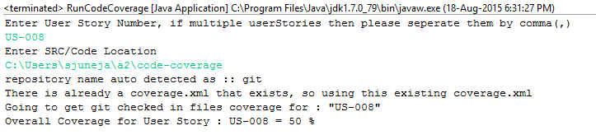
Standalone Program Screenshot
---------------------------------------------------------------------------------------------------------
!Note: to build a standalone executable jar, use command “clean compile assembly:single” to build the standalone project

Slide 16
Thank You!

